Slide 1
Naviance eDocs
Cobb County
Notes:
Notes

Slide 2
College Application Process Using eDocs
Create Common App account
Sign CA FERPA release waiver
Match CA account in Naviance
Add colleges to application list
Request LORs and transcripts
STUDENTS
Manage LOR and transcript requests
Prepare school-wide documents
Prepare student-specific documents
Send documents
Track submitted documents
STAFF
Student requests mid-year & final materials
Staff prepares & sends mid-year materials
Staff prepares & sends final materials
FOLLOW-UP

Slide 3
REVIEW - Student Action Steps
Register with Common App after August 1 (Common App Only)
On commonapp.org, enter high school information, add at least one college, and sign the FERPA Release Authorization (Common App Only)
Complete the Common App Account Matching process in Naviance Student (for Common App colleges only)
Add Common App colleges on commonapp.org* and add non-Common App colleges to the Colleges I'm Applying To list in Naviance Student
Request materials for college applications in Naviance Student (teacher recommendations/transcripts)

Slide 4
REVIEW - Student College Application Flow
Match Common App account to Naviance Student
1
Add non-Common App colleges to the Colleges I'm Applying To list
2
Request application and transcripts for Common App and non-Common App colleges via Naviance Student
4
Track status of requested transcripts and recommendations
3
Request teacher recommendation letters via Naviance Student

Slide 5
Steps 1a: Creating Common App Account / Signing the FERPA Release Waiver
Student Process
Students should follow the steps in this video to learn how to setup their Common App account & how to sign the FERPA Release Waiver.

Slide 6
Step 1b: Matching the Common App Account in Naviance
Student Process
Students should follow the steps in this video to learn how to match their Common App Account in Naviance.
Go to Colleges I’m Applying To List
Select the hot pink bar to Match Accounts
Enter the email address used for the Common App account
Confirm that the birthdate is correct
Select Match Accounts
Once a student has matched their account, schools from their application list in Common App will feed into their Colleges I’m Applying To list in Naviance

Slide 7
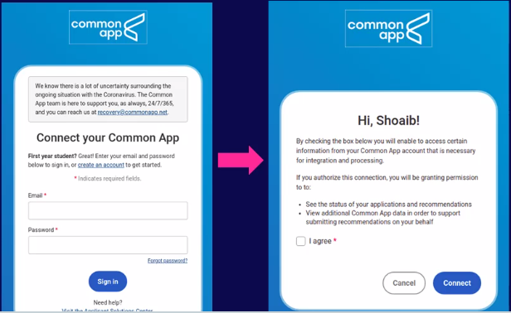
Match your Common App Account (Video: 2021 Common App Account Matching)
Select Match Accounts.
Students will be redirected to log into their Common App account
Enter the email address that you used in Common App account
5. Select I agree option and Connect button
4. Enter password
All your Common Applications will automatically feed into your Colleges I’m Applying to list in Naviance. Now, you should request transcripts & Letters of Recommendation in Naviance!

Slide 8
Step 2a: Add colleges to Colleges I’m Applying To list
Student Process
Go to Colleges I’m Applying To List
Select the pink plus sign to add a college to the application list
Search for the name of the school and select Add Application & Request Transcript
Select App Type (e.g., RD, ED, EA, etc.)
Select How You’ll Submit Your App (e.g., Common App, Direct to Institution)
Select the type of transcript being requested, if any.
Select any other schools that need transcripts
Select Request and Finish
Students should only add colleges to this list and request transcripts if they have already applied to the school or are very certain they will apply in the future

Slide 9
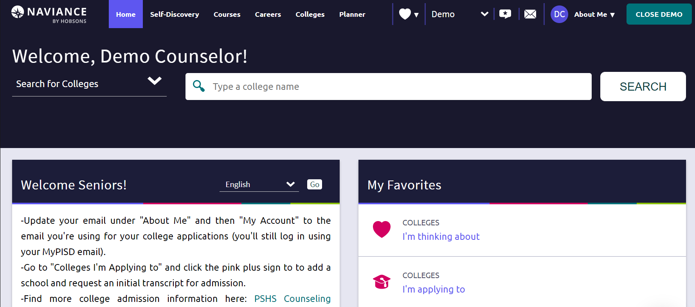
Go to Colleges I’m Applying To List
Select “Colleges I’m Applying To” from My Favorites on your homepage
Show Me How:
Self-Guided Tours for help with College Tools. Look on the bottom right of each screen

Slide 10
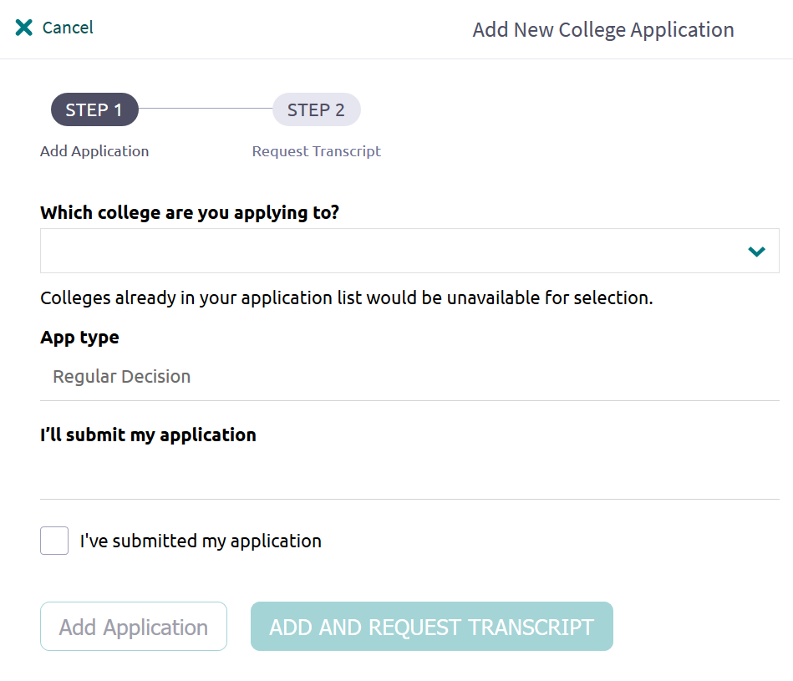
Add a college to your list
1. Select the Pink Plus Sign
2. Type in the name of the school you want to apply to
3. Indicate your application type
4. Say how you’re applying
6. Select Add Application for application documents only or Add And Request Transcript for application documents and transcript request.
5. Check the box if you’ve submitted your application

Slide 11
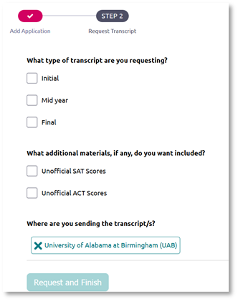
Request Transcript
1. Select the type of transcript you are requesting
2. Indicate any additional materials you want included
3. Ensure School name is correct.
4. Select Request and Finish

Slide 12
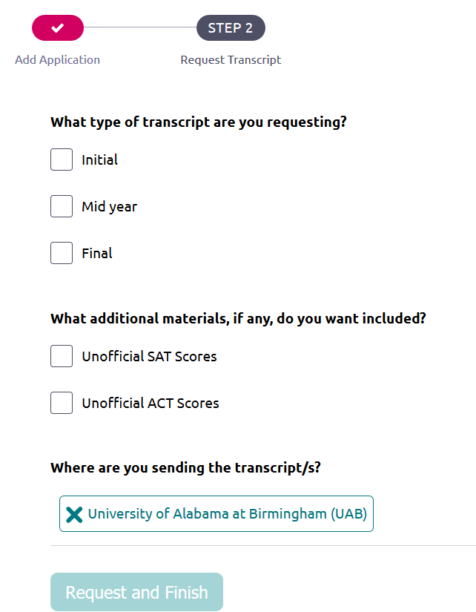
Step 2b: Request Transcripts
Student Process
Requesting Transcripts
Go to Colleges I’m Applying To List
Select Request Transcripts at the top of the list
Select the type of transcript being requested
Select any other schools that need transcripts
Select Request and Finish
Note: You should only request transcripts if you have already applied to the school or are very certain you will apply in the future

Slide 13
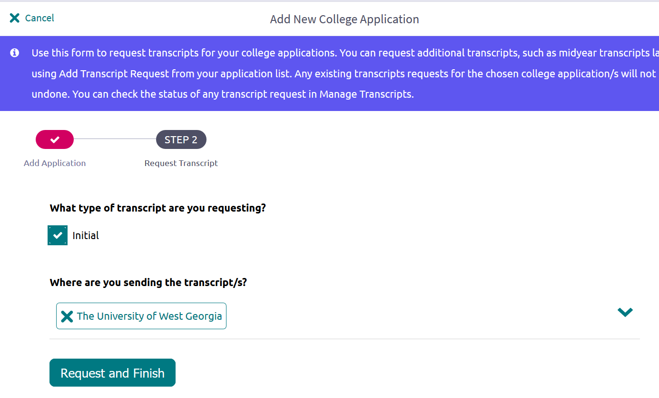
Request a Transcript
1. Select the Type of transcript you’re requesting
2. Confirm which school you’re requesting for
3. Add any more schools you’d like a transcript for
4. Request and Finish

Slide 14
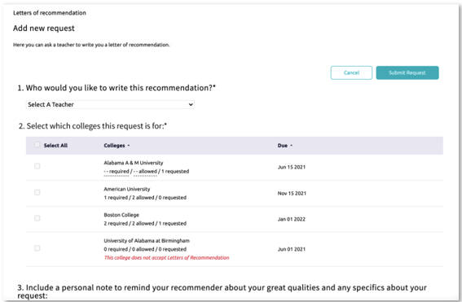
Step 3: Request Letters of Recommendation
Student Process
Requesting LORs
Go to Colleges I’m Applying To List
Under Apply to College, select Letters of Recommendation
Select Add Request
Select a Teacher
Select which colleges the request is for
Include a personal note
Select Submit Request
Select Request and Finish

Slide 15
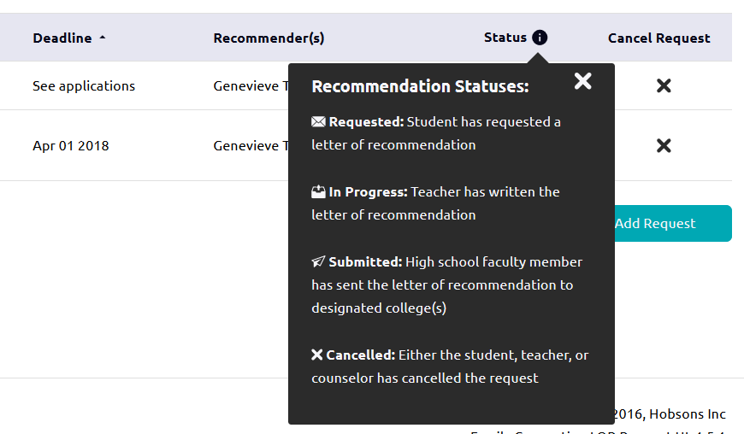
Step 4: Track Submission Status in Naviance
Student Process
Tracking Transcript & App Materials Status
Go to Colleges I’m Applying To List
Check the Transcript column to review when a counselor has submitted a transcript
The transcript column will say ‘sent’ if the transcript has been sent
Check the Office Materials column to review when a staff member has indicated that all materials have been sent for that application
The Office Materials column will say ‘submitted’ if transcripts and any other required materials, like Common App forms or other school-specific forms, have been sent
Tracking LOR Status
Go to Colleges I’m Applying To List
Select Letters of Recommendation at the bottom of the list
Check the Status column to review when a teacher has submitted a LOR

Slide 16
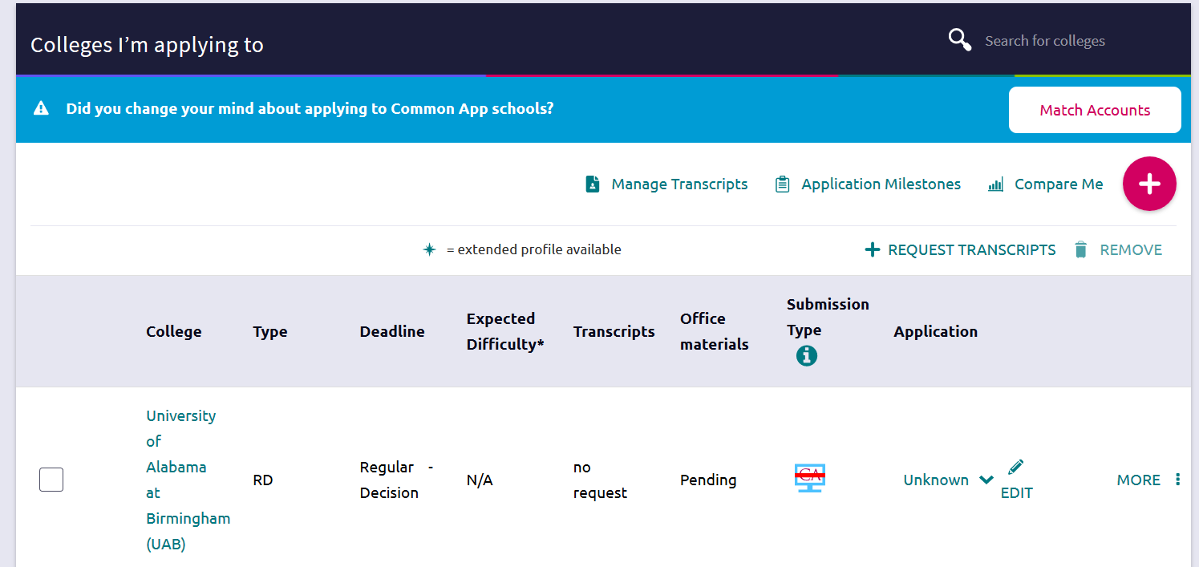
Check Transcript Request Status
How do I request more transcripts? Select Request Transcripts
How do I know if my transcript has been sent?
Watch the Transcript Request column to determine when the transcript has been sent
How do I know if my counselor has submitted everything I need for an application? If the Office Materials column says “submitted”, this means all necessary materials from your school have been sent

Slide 17
eDocs Delivery Type Icons
Mail Only: documents can only be sent by mail
Electronic: documents can be sent through eDocs
Common App: Common App docs can be sent through eDocs
Unknown: documents can be sent through eDocs. Student has not yet indicated how they are applying
Common App via Electronic: documents can be accepted through eDocs
Common App Mail only: documents prepared but not sent through eDocs

Slide 18
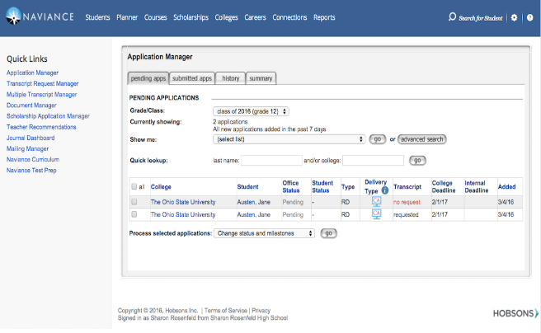
Questions?

